Slide 1

Web Design and Development
Raghu Prasad
9845547471
www.kaushalya.tech
FB : https://www.facebook.com/raghuprasadkonandur/
Skill Up-Skill Re-Skill
Excellence in action

Slide 2

Introduction
Raghu Prasad – BE, MS
Total of 24 years of experience
7 years as a lecturer in an Engineering College
17 Years into IT
Worked with companies like CISCO,CSC,ICICI,First Apex – NTT Data
Currently into Corporate training and consultancy
Worked with corporates and public sector
Service Offerings – In person/On-line/Corporate/Academic Institutes
Technologies – Java,Python,Web technologies,Java Script technologies (MEAN stack),IOT,Test Automation,Machine Learning,Artificial Intelligence,ERP
Customers – Philips,L & T,NextGen,Incarnus,Aspire Technologies,BGS-IT,Sindhi College,Malnad Enginering College,S B College of Management,REVA University,Nagarjuna Institute of Technology

Slide 3
Topics
Introduction to World Wide Web
Introduction to Web Design
Types of Designers
Introduction to Web Development
Web Design and Development Life Cycle
Wire frame
Visual Design
Use case of sample wire frame and visual design

Slide 4
What is Web ?
The World Wide Web (WWW), also called the Web, is an information space where documents and other web resources are identified by Uniform Resource Locators (URLs), interlinked by hypertext links, and accessible via the Internet.
English scientist Tim Berners-Lee invented the World Wide Web in 1989. He wrote the first web browser in 1990 while employed at CERN in Switzerland.The browser was released outside CERN in 1991, first to other research institutions starting in January 1991 and to the general public on the Internet in August 1991.

Slide 5
What is Web ?
The World Wide Web has been central to the development of the Information Age and is the primary tool billions of people use to interact on the Internet.
Web pages are primarily text documents formatted and annotated with Hypertext Markup Language (HTML).In addition to formatted text, web pages may contain images, video, audio, and software components that are rendered in the user's web browser as coherent pages of multimedia content.

Slide 6
What is Web ?
Embedded hyperlinks permit users to navigate between web pages. Multiple web pages with a common theme, a common domain name, or both, make up a website.
Website content can largely be provided by the publisher, or interactively where users contribute content or the content depends upon the users or their actions.
Websites may be mostly informative, primarily for entertainment, or largely for commercial, governmental, or non-governmental organisational purposes.
How internet works https://www.youtube.com/watch?v=5o8CwafCxnU&index=3&list=PLzdnOPI1iJNfMRZm5DDxco3UdsFegvuB7
https://www.quora.com/What-is-the-difference-between-TCP-and-IP-protocols

Slide 7
What is Web design ?
Web design governs everything involved with the visual aesthetics and usability of a website—color scheme, layout, information flow, and everything else related to the visual aspects of the UI/UX (user interface and user experience).
Web design is concerned with what the user actually sees on their computer screen or mobile device, and less so about the mechanisms beneath the surface that make it all work. Through the use of color, images, typography and layout, they bring a digital experience to life.

Slide 8
What is Web design ?
Some common skills and tools that distinguish the web designer from the web developer are:
Adobe Creative Suite (Photoshop, Illustrator) or other design software
Graphic design
Logo design
Layout/format
Placing call-to-action buttons
Branding
Wireframes, mock-ups, and storyboards
Color palettes
Typography

Slide 9
Types of Designers
Graphic Designer
Graphic design is a form of visual communication and leverages images and other visual elements to convey ideas. It has become an umbrella term for various types of design work.
From logos to billboards to packaging for products, graphic designers bring concepts, ideas, and stories to life using typography, shapes, color, and images. They educate and inspire customers to learn more about something, to make a purchase, or to sign up. They use software such as Photoshop and InDesign to create static images and lay out pages. Designers who focus on printed materials like magazines or brochures are also known as print designers.

Slide 10
Types of Designers
Graphic designers create:
Visual identity: logos, letterhead, business cards
Marketing materials: brochures, flyers, postcards, posters
Magazines, books, catalogs
Product packaging
Presentations
T-shirt designs
Annual reports
Illustrations
Skills: Photoshop, InDesign, Illustrator

Slide 11
Types of Designers
INTERACTIVE/WEB DESIGNER
From landing pages and blog templates to entire websites and mobile apps, the digital space is an interactive designer’s domain.
Creating a beautiful design is only part of the job. Interactive or web designers also need to understand the technology used to build websites and turn their designs into actual online experiences. As a result, some designers may have an understanding of front-end web development and might know programming languages such as JavaScript. That said, content management systems or CMS, such as WordPress and Drupal, are widely used for many websites today. They make it easier for designers to customize premade templates and themes without needing to work with a developer or know programming languages.

Slide 12
Types of Designers
In general, web designers will know Adobe Creative Suite (Photoshop, Illustrator, etc.) and some may also know CSS and HTML.
Because of the complexity of the web, there are many relatively new (and in-demand) skills designers may specialize in:
User experience (UX): explores the experience people have using a site, app, or tool to ensure it’s easy to use and not confusing.
User interface (UI): involves how people navigate through a site, app, or tool, using elements such as buttons, menus, color, and images.
Many designers may be skilled at both UX and UI.

Slide 13
Types of Designers
Interaction design: focuses on how people are involved with the experience of the product, for example, a progress bar that shows where you are while signing up for a site or an icon that changes color to signal you’ve turned on a setting.
Information architecture (IA): involves creating the blueprint for a website by making sure it’s organized in an understandable way. Information architects come from a variety of backgrounds, including design, writing, library science, and psychology.

Slide 14
Types of Designers
Interaction design: focuses on how people are involved with the experience of the product, for example, a progress bar that shows where you are while signing up for a site or an icon that changes color to signal you’ve turned on a setting.
Information architecture (IA): involves creating the blueprint for a website by making sure it’s organized in an understandable way. Information architects come from a variety of backgrounds, including design, writing, library science, and psychology.

Slide 15
Types of Designers
Interactive designers create:
Websites, landing pages, microsites, web pages
Blog templates and themes
Mobile apps
Banner ads
Social media assets
Email marketing assets
Skills: Photoshop, Illustrator, Dreamweaver, CSS, HTML, wireframing, prototyping

Slide 16
Types of Designers
MOTION GRAPHICS DESIGNER
The world of the motion graphics designer evolves frame by frame. Whether they’re creating an explainer video or the opening title sequence of a movie, motion graphics designers bring movement to otherwise static images, text, illustrations, and more. For instance, to develop an online video, they typically will start by creating storyboards that map out each scene based on a script. From there, they put the scenes and images together, adding motion and graphical elements to ensure it moves seamlessly from frame to frame. They also sync up the action in each scene with a voiceover or music.

Slide 17
Types of Designers
Motion graphics designers create:
Explainer videos
Storyboards
Promotional videos
Animated graphics (for TV shows, for example)
Movie title sequences
Product demos
Animated presentations
Skills: Illustrator, Photoshop, After Effects, Final Cut Pro, Cinema 4D, Maya

Slide 18
Types of designers
ANIMATOR
Without animators, we wouldn’t have been enchanted by Elsa in Frozen, hooked on Halo, or transported to Middle-Earth in The Lord of the Rings. From animated films to special effects to video games, animators bring stories, characters, and entire other worlds to life through software such as 3ds Max, Maya, Cinema 4D, After Effects, and Blender. Designs can be two-dimensional (2D) or three-dimensional (3D).
Animators create:
Movie special effects
Animated films
Video games
Skills: 3ds Max, Maya, Cinema 4D, Blender, After Effects, Flash, Photoshop

Slide 19
What is Web Development ?
Web development governs all the code that makes a website tick.
It can be split into two categories—front-end and back-end.
The front-end or client-side of an application is the code responsible for determining how the website will actually display the designs mocked up by a designer.
The back-end or server-side of an application is responsible for managing data within the database and serving that data to the front-end to be displayed. As you may have guessed, it’s the front-end developer’s job that tends to share the most overlap with the web designer. Some common skills and tools traditionally viewed as unique to the front-end developer are listed below:

Slide 20
What is Web Development ?
HTML/CSS/JavaScript
CSS preprocessors (i.e., LESS or Sass)
Frameworks (i.e., AngularJS, ReactJS, Ember)
Libraries (i.e., jQuery)
Git and GitHub
Front-end web developers don’t usually create mock-ups, select typography, or pick color palettes—these are usually provided by the designer.
It’s the developer’s job to bring those mock-ups to life. That said, understanding what the designer wants requires some knowledge of best practices in UI/UX design, so that the developer is able to choose the right technology to deliver the desired look and feel and experience in the final product.

Slide 21
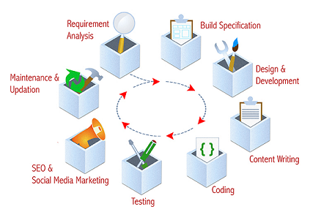
Life cycle

Slide 22
Design – Sample Wireframe
For most web designers the first phase of any given web project is wireframing. It allows the designer to map out exactly how the structure of the website can work, as well as the general layout direction of important elements such as navigations, forms, and content sections.
Each designer often has their own unique way of producing these wireframes. Many work off paper, while others prefer to go straight into creating them on a computer using tools like Balsamiq, Figma or Sketch. Either way, the results are often fascinating, and more often than not are visually impressive despite their supposed roughness and simplicity.
https://1stwebdesigner.com/wireframes-web-design/

Slide 23
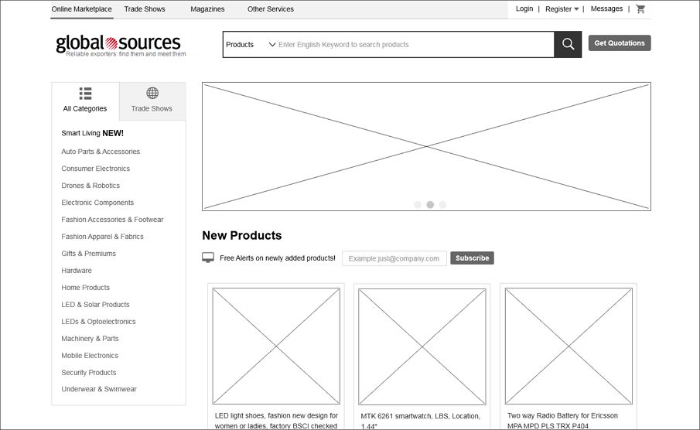
Design-Global Sources Wireframe

Slide 24
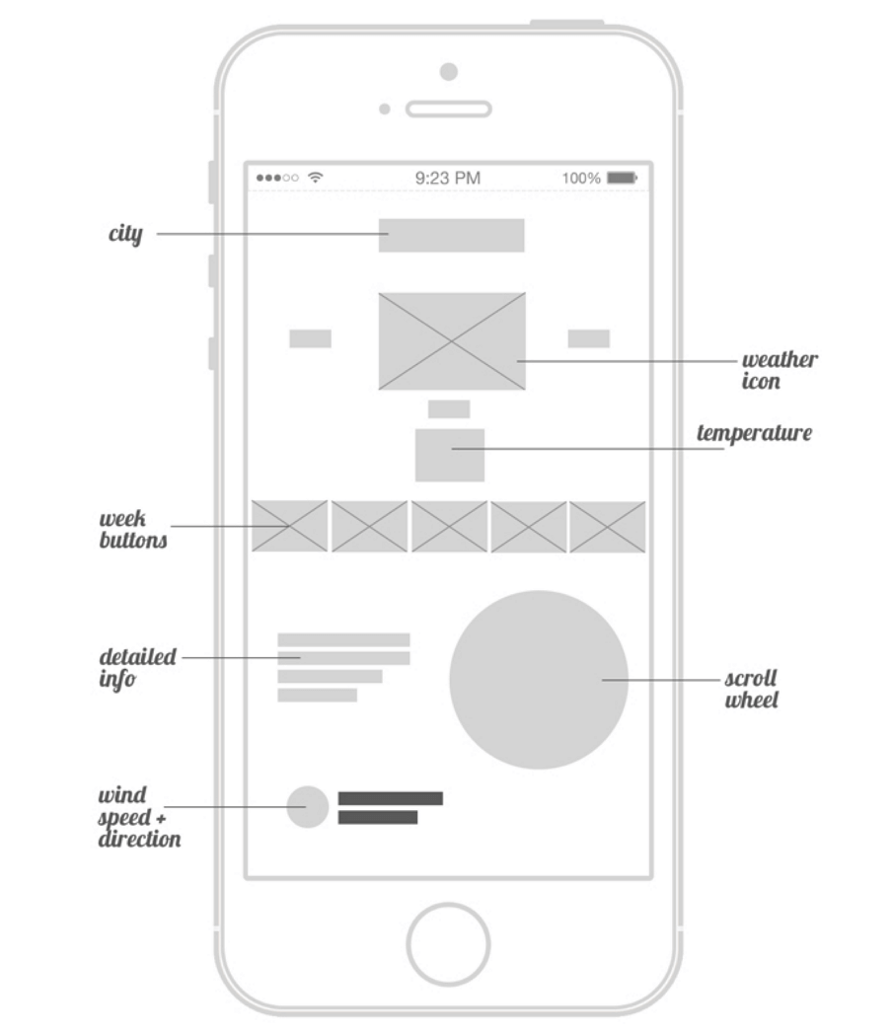
Design-Weather App Wireframe

Slide 25
Visual Design
Visual design aims to shape and improve the user experience through considering the effects of illustrations, photography, typography, space, layouts, and color on the usability of products and on their aesthetic appeal. To help designers achieve this, visual design considers a variety of principles, including unity, Gestalt properties, space, hierarchy, balance, contrast, scale, dominance, and similarity.
Visual design as a field has grown out of both user interface (UI) design and graphic design. As such, it focuses on the aesthetics of a product and its related materials by strategically implementing images, colors, fonts, and other elements.

Slide 26
Visual Design
A successful visual design ensures that content remains central to the page or function, and enhances it by engaging users and helping to build their trust and interest in the product (and, consequently, the brand)
More about visual design …
https://www.interaction-design.org/literature/topics/visual-design

Slide 27
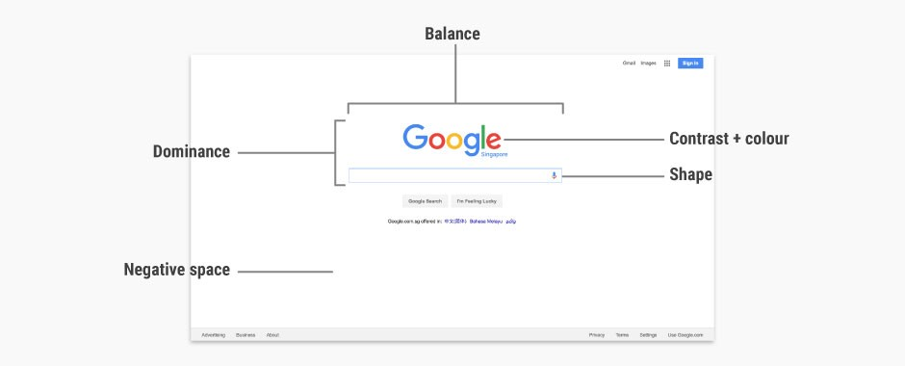
Visual Design - Google

Slide 28
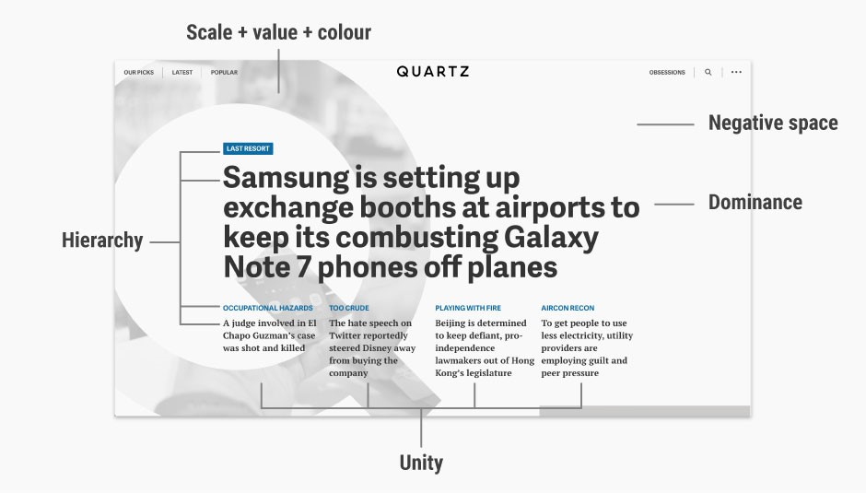
Visual Design – Quartz - https://qz.com/india/

Slide 29
Thank You
Raghu Prasad
9845547471
www.kaushalya.tech
FB : https://www.facebook.com/raghuprasadkonandur/
Skill Up-Skill Re-Skill
Excellence in action

